Slide 1

VRS & YRN COLLEGE OF ENGINEERING &TECHNOLOGY
LAND REAL ESTATE REGISTRATION USING BLOCKCHAIN
Presented By
1.M.Amala (18L11A0511)
2.k.Anusha (18L11A0510)
3.J.Srinivasa Rao (17L11A0507)
4.B.V.SumanthKumar (18L11A0510)
Under the Guidance Of
A.Satish Kumar

Slide 2
Contents
Introduction
Blockchain definition
Advantages and disadvantages of blockchain
Existing & Proposed Systems
Software and hardware requirements
UML Diagrams
Modules
Working of Real Estate Registration
Output Screenshots
Advantages and Disadvantages of land real estate registration
Conclusion

Slide 3

Introduction
The aim of the project has been to present Online real estate Registration in India in the context of good governance, and to suggest some indicators for assessing the procedures in these systems in terms of their efficiency.
This application also allows users to see land details on online. This application mainly concentrates on maintaining and managing the details of the property. This application deals with lands details.
seller
Broker
buyer

Slide 4
Blockchain
Blockchain is a shared, immutable ledger that facilitates the process of recording transactions and tracking assets in a business network
The goal of blockchain is to allow digital information to be recorded and distributed, but not edited
Blockchain technologies are the digital, distributed, and decentralized ledger.
data
block
block
B2 encrypt the data using the B1 block data using sha 256 algorithm
Blocks
block
block

Slide 5
Advantages and Disadvantages
Advantages of blockchain:
Data Integrity
Distributed
Traceability
Immutability
Stability
Security
Faster processing
No third party interference
Disadvantages of blockchain:
Cost
Immaturity
Time-Consuming
Elimination of Errors
Difficulty of Development

Slide 6
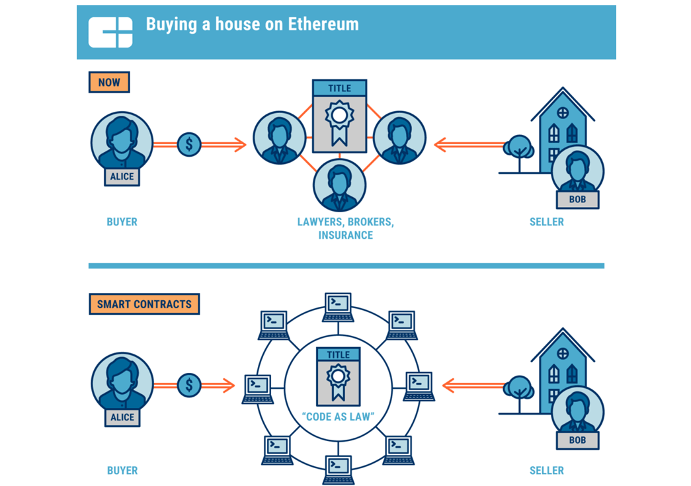
Existing & Proposed Systems

Slide 7
Hardware and Software Requirements
HARDWARE REQUIREMENTS:
Processor : Pentium IV 2.4 GHz.
Hard Disk : 40 GB.
Ram : 512 Mb.
SOFTWARE REQUIREMENTS:
Operating System : Windows
Coding Language : Python 3.7

Slide 8
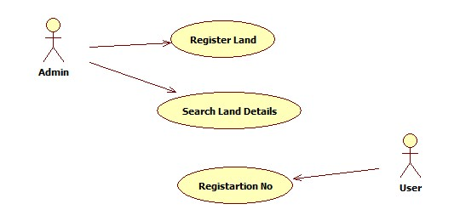
Uml Diagrams
Use Case Diagram:

Slide 9
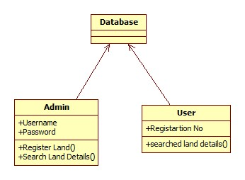
Class Diagram:

Slide 10
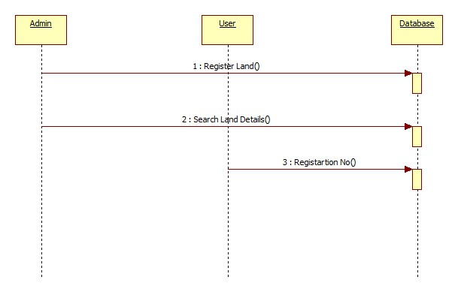
Sequence Diagram:

Slide 11
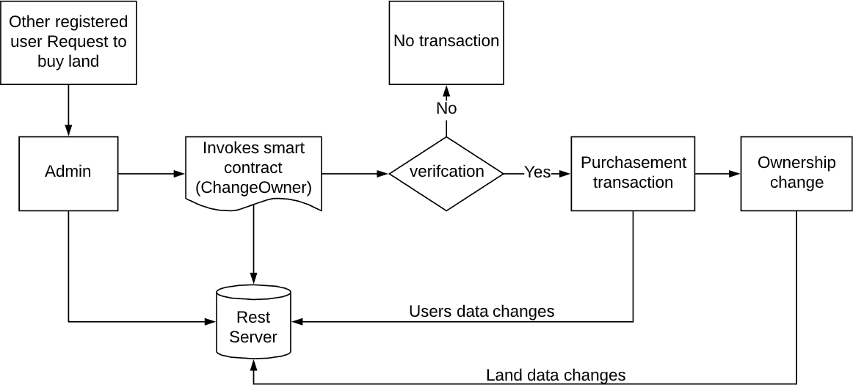
Modules
To implement this project we have designed following modules
Admin: admin user can login to application by using username as admin and password as admin and after login admin can add new land registration details and then can search land details. Admin will issue registration number to each user land.

Slide 12
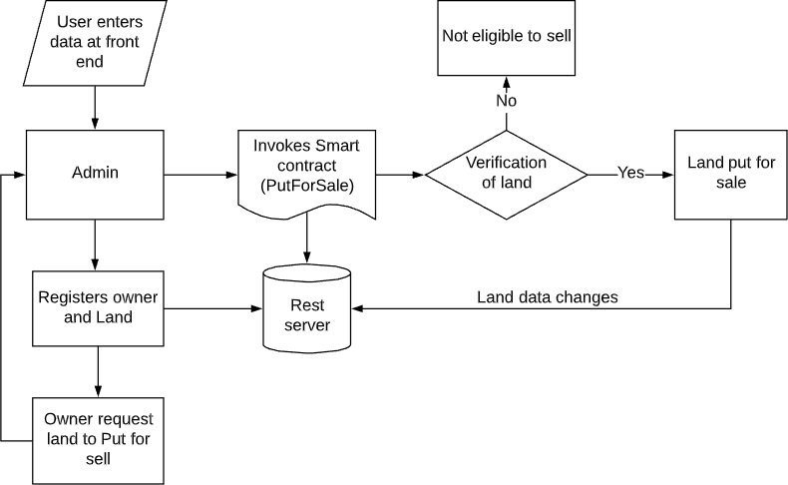
2. User module: User can search registered plot details by entering plot registering number.

Slide 13
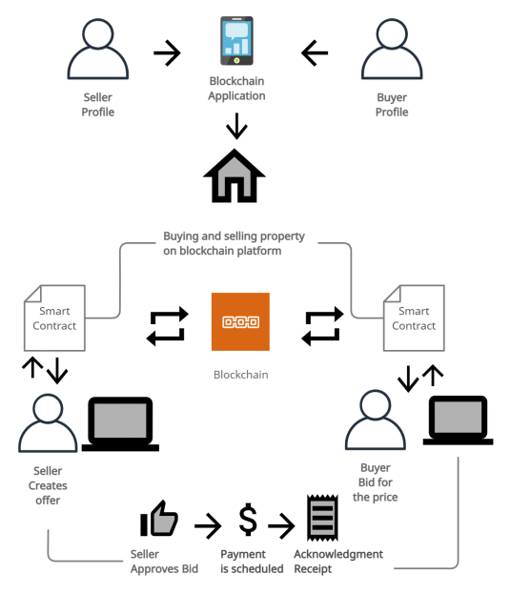
Working Of Real Estate Registration

Slide 14
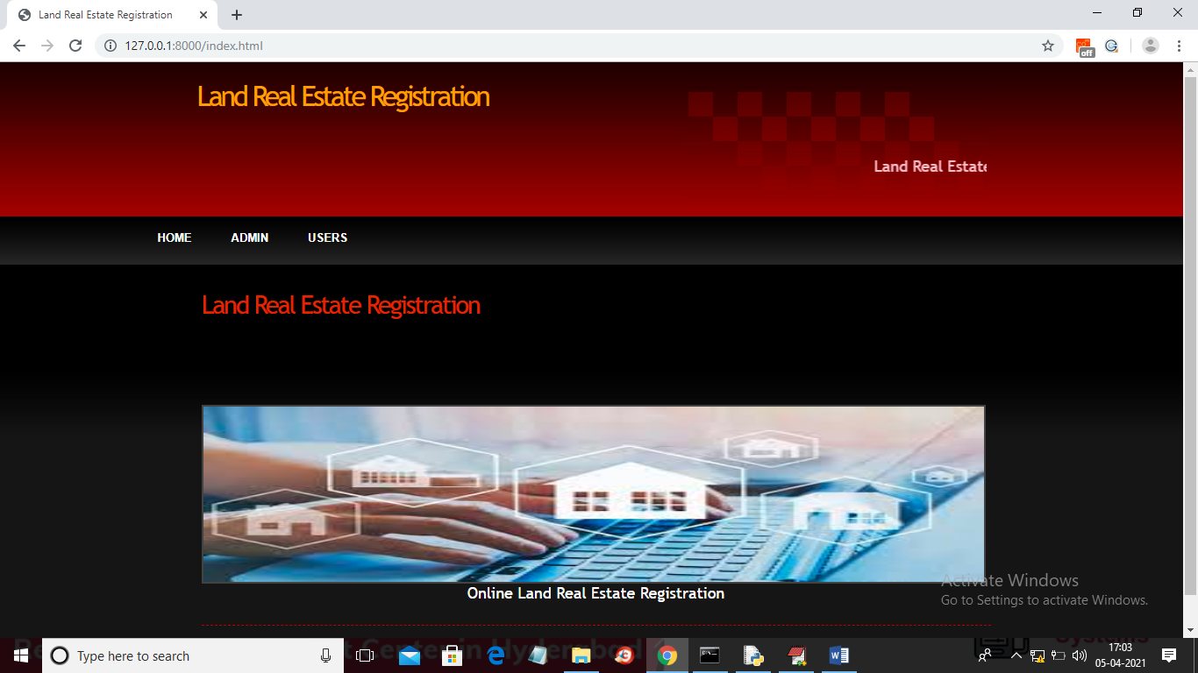
Output Screenshots
Fig:Home Page

Slide 15
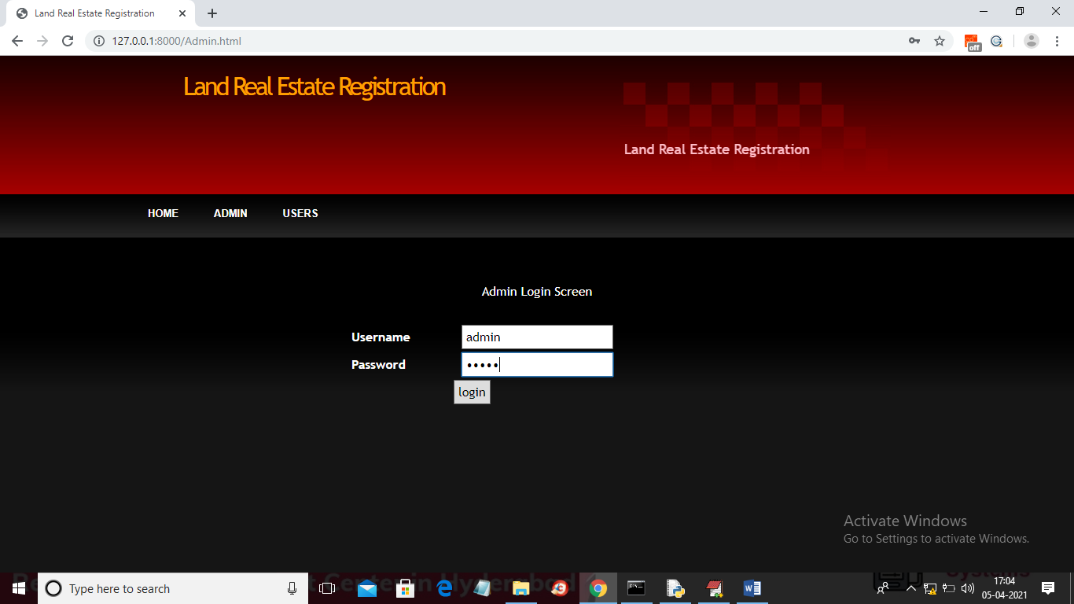
Fig:Admin Login Page

Slide 16
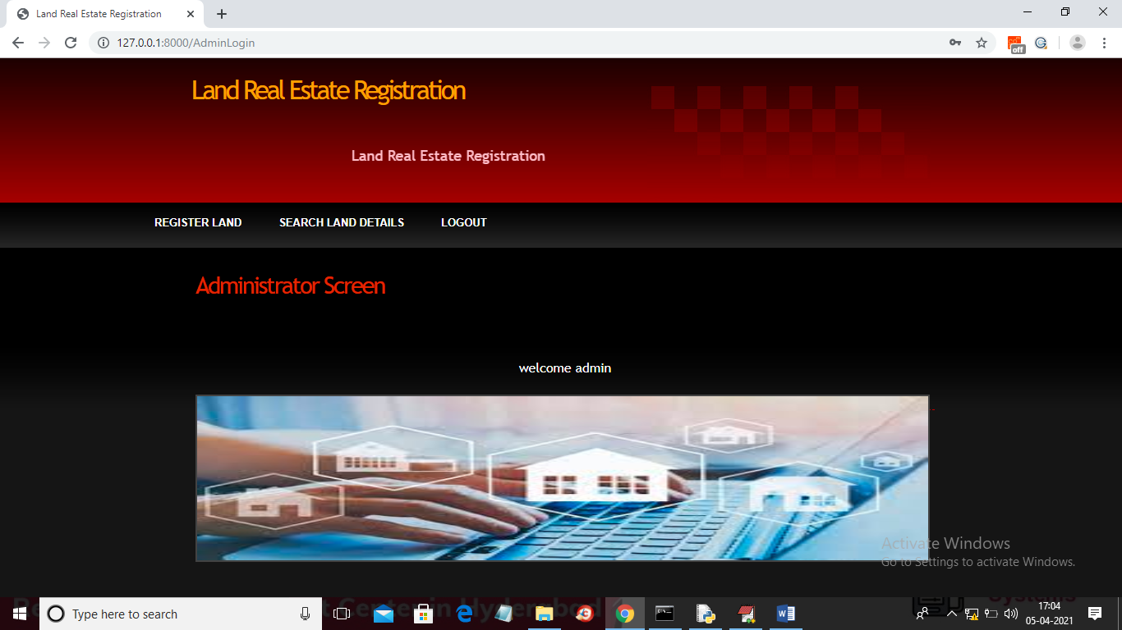
Fig:Administrator Screen

Slide 17
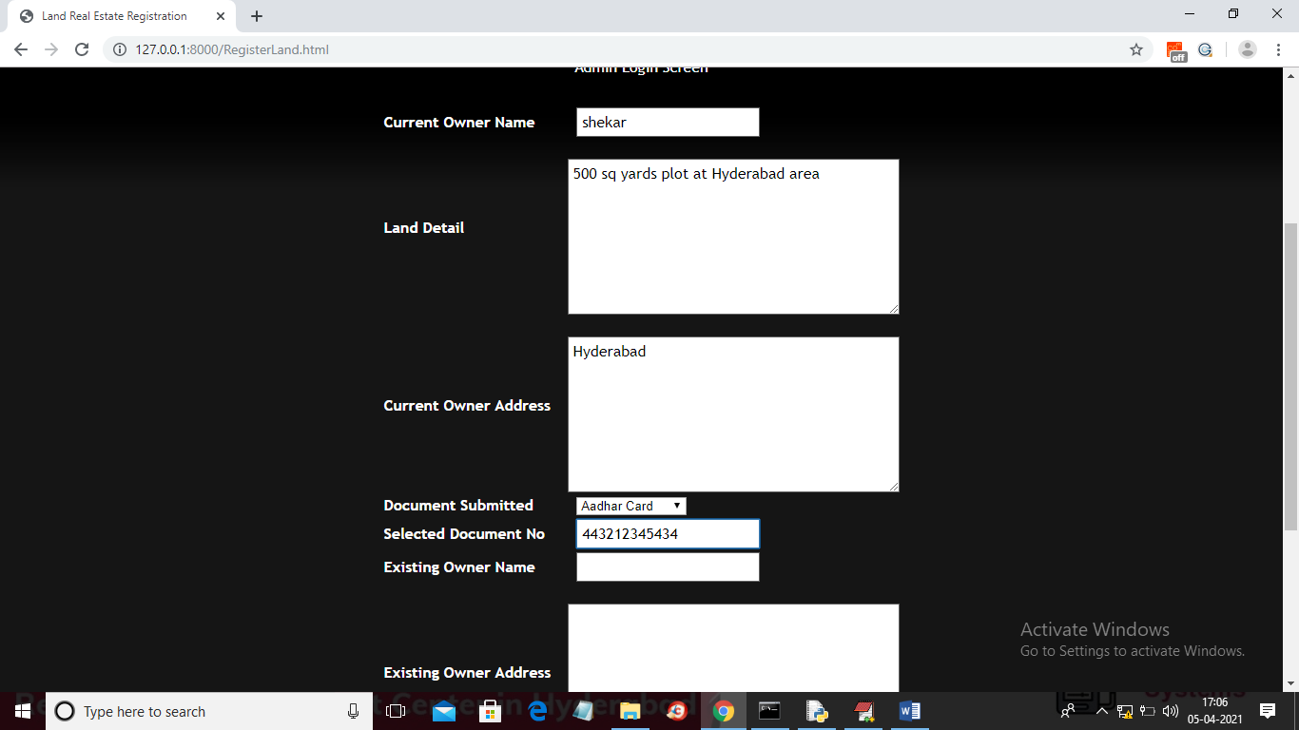
Fig:Admin Resgistrating Land details

Slide 18
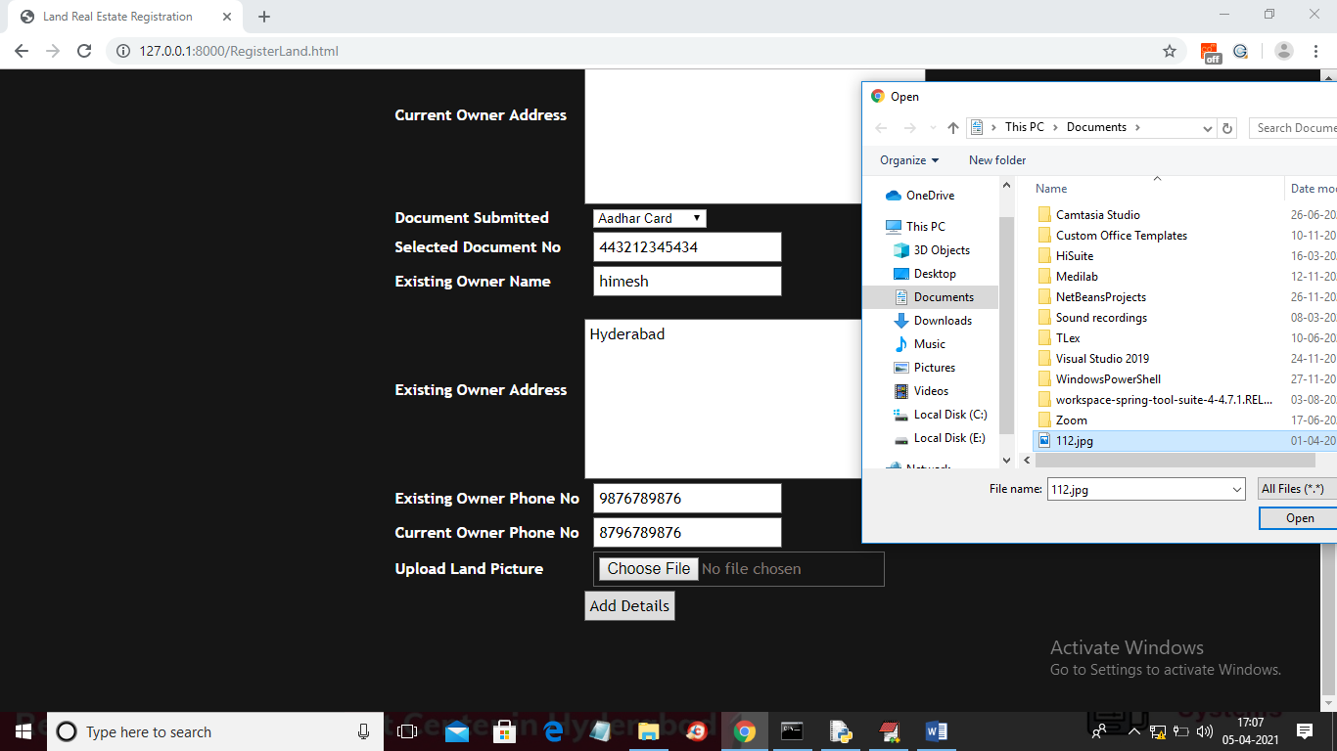
Fig:Admin Uploading Confidential Data

Slide 19
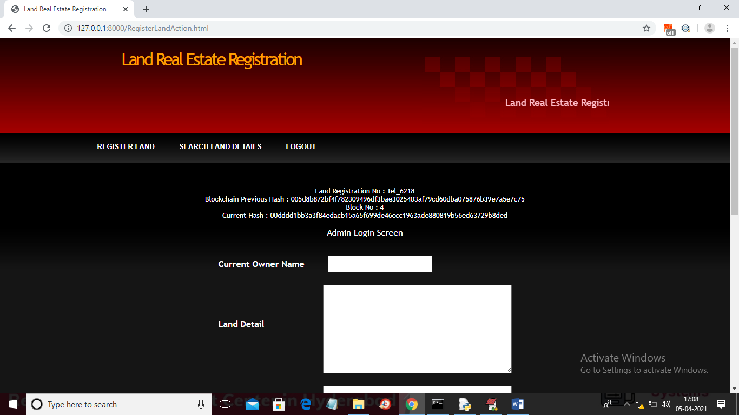
Fig:Admin Sesarching Land Details

Slide 20
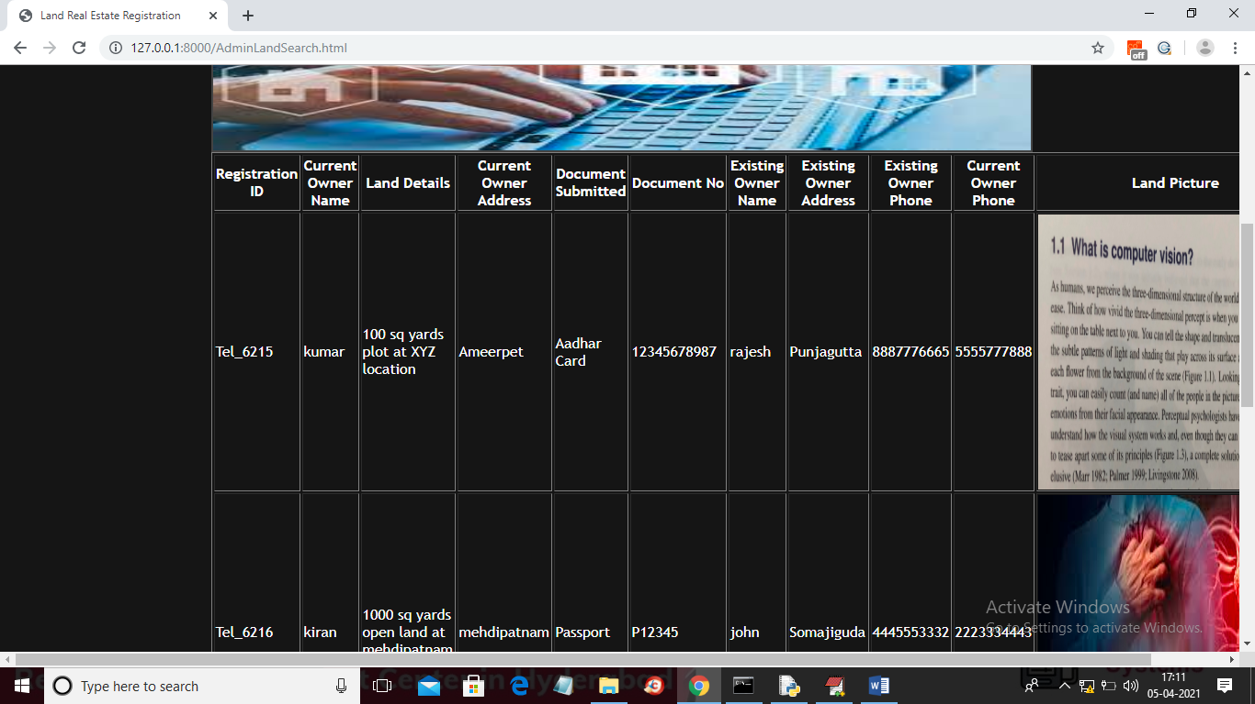
Fig:Land Details

Slide 21
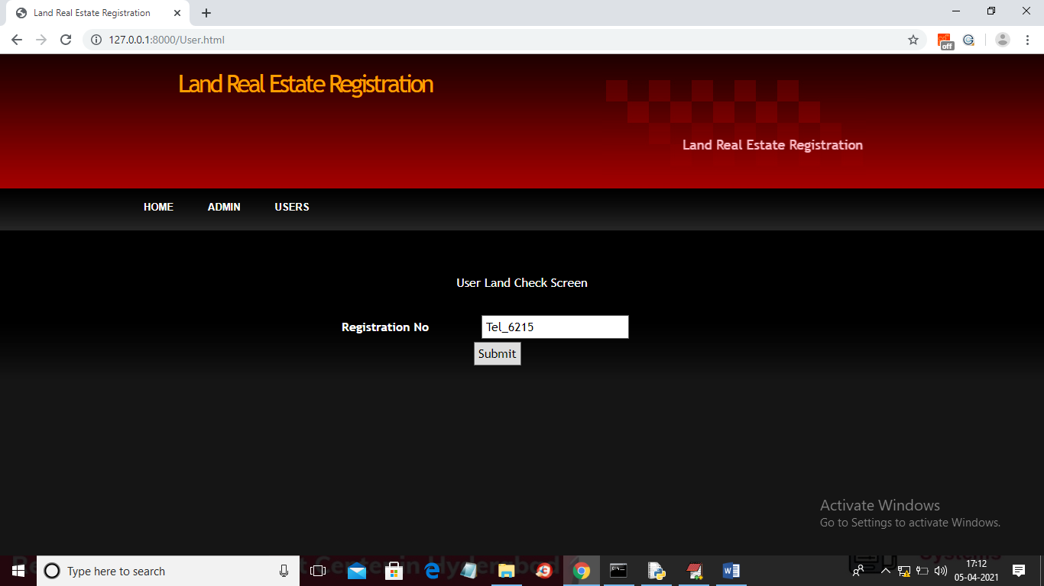
Fig:User Login Page

Slide 22
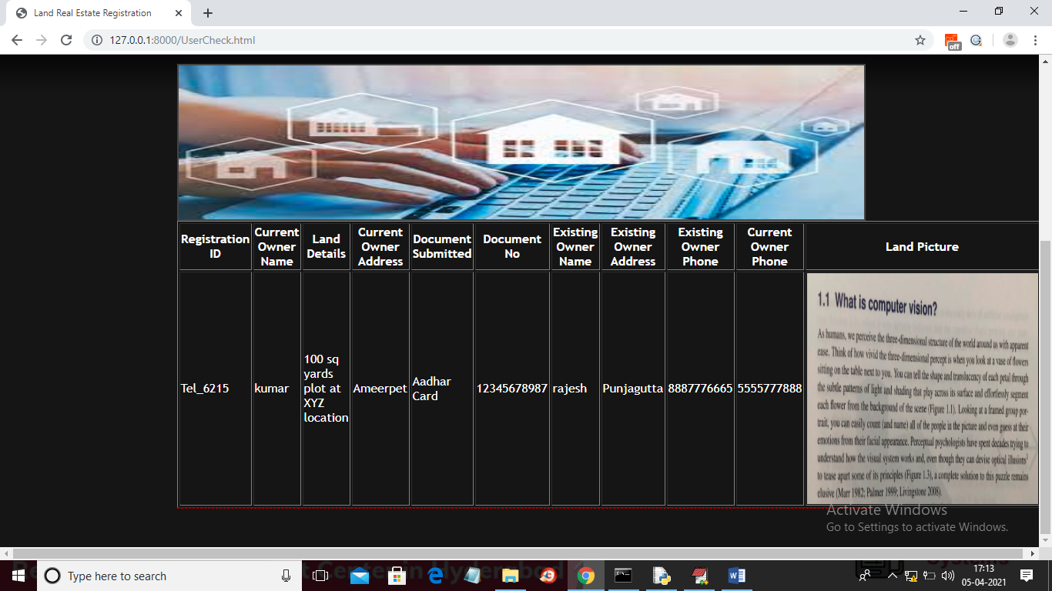
Fig:Land Details Searched By User

Slide 23
Advantages and Disadvantages Of Land Real Estate Registration
Advantages of land real estate registration:
High secure
Immutable
Easy to work
Consumes less time
No intruders involved
Efficient
Disadvantages of land real estate registration:
Immutable
Difficulty of development
Elimination of errors

Slide 24
Conclusion
Blockchain is one of the most secure ways of storing data without it being changed. It is a distributed ledger that is open to anyone and once data is put into it, it is very difficult to change or meddle with it. Using this property of blockchain we want to put it to use into one of the most fraudulent systems in India, the Land Registration System. Our system uses blockchain with the employment of hyperledger.This gives rise to a system that is more evolved and features all the activities like buying and selling in an efficient and reliable way. Blockchain technology made this system secure and faster.

Slide 25
Queries?

